Slide 1
TSFM GENE MUTATION

Slide 2
AGENDA
Definition;
  tsfm gene and TSFM gene mutation
Biochemistry
  Oxidative phosphorylation
  Lactic acidosis
  Citric acid cycle
conclusion

Slide 3
definition
Tsfm gene
  This is a protein coding gene responsible for encoding a mitochondrial translation elongation factor.
TSFM GENE MUTATION.
  Action by the TSFM gene that is associated with a combined oxidative phosphorylation deficiency.
  In cases of alternative splicing leads to multiple transcript variants.
Notes:
The encoded protein is basically an enzyme acting as a catalyst in the exchange of guanine nucleotides on the translation elongation factor Tu (Perli et al 5108).
This occurs during elongation step of mitochondrial protein translation.
Another disease associated with TSFM is the combined oxidative phosphorylation deficiency 3.

Slide 4
biochemistry
      Oxidative phosphorylation

Slide 5
Oxidative phosphorylation
This is a termination of a sequence of energy transformation. it can be referred to as respiration or simple respiration in their entirety.
It is considered to be a metabolic pathway by which there is oxidation of nutrients by cells which use enzymes for the oxidation process.
During oxidative phosphorylation, there is the transfer of electrons donors to electron acceptors. For example oxygen in redox reaction that release the energy that is stored in some relatively weak double bonds of oxygen. This is used in the formation of ATP.
Notes:
In eukaryotes, the redox reactions are usually catalyzed by a sequence of protein complexes.
The protein complexes are within the inner membrane of cell’s mitochondria.
In the prokaryotes, the proteins are within the cell’s intermembrane space (Weber et al 58).
When these sets of proteins are linked together, they form the electron transport chains used to transport protons across the inner mitochondrial membrane.
The oxidative phosphorylation is known to be a crucial metabolism that produces reactive oxygen species for example, hydrogen peroxide and superoxide. These are responsible for propagation of free radicals which damage cells, cause diseases and possible chances of aging(Weber et al 58).

Slide 6
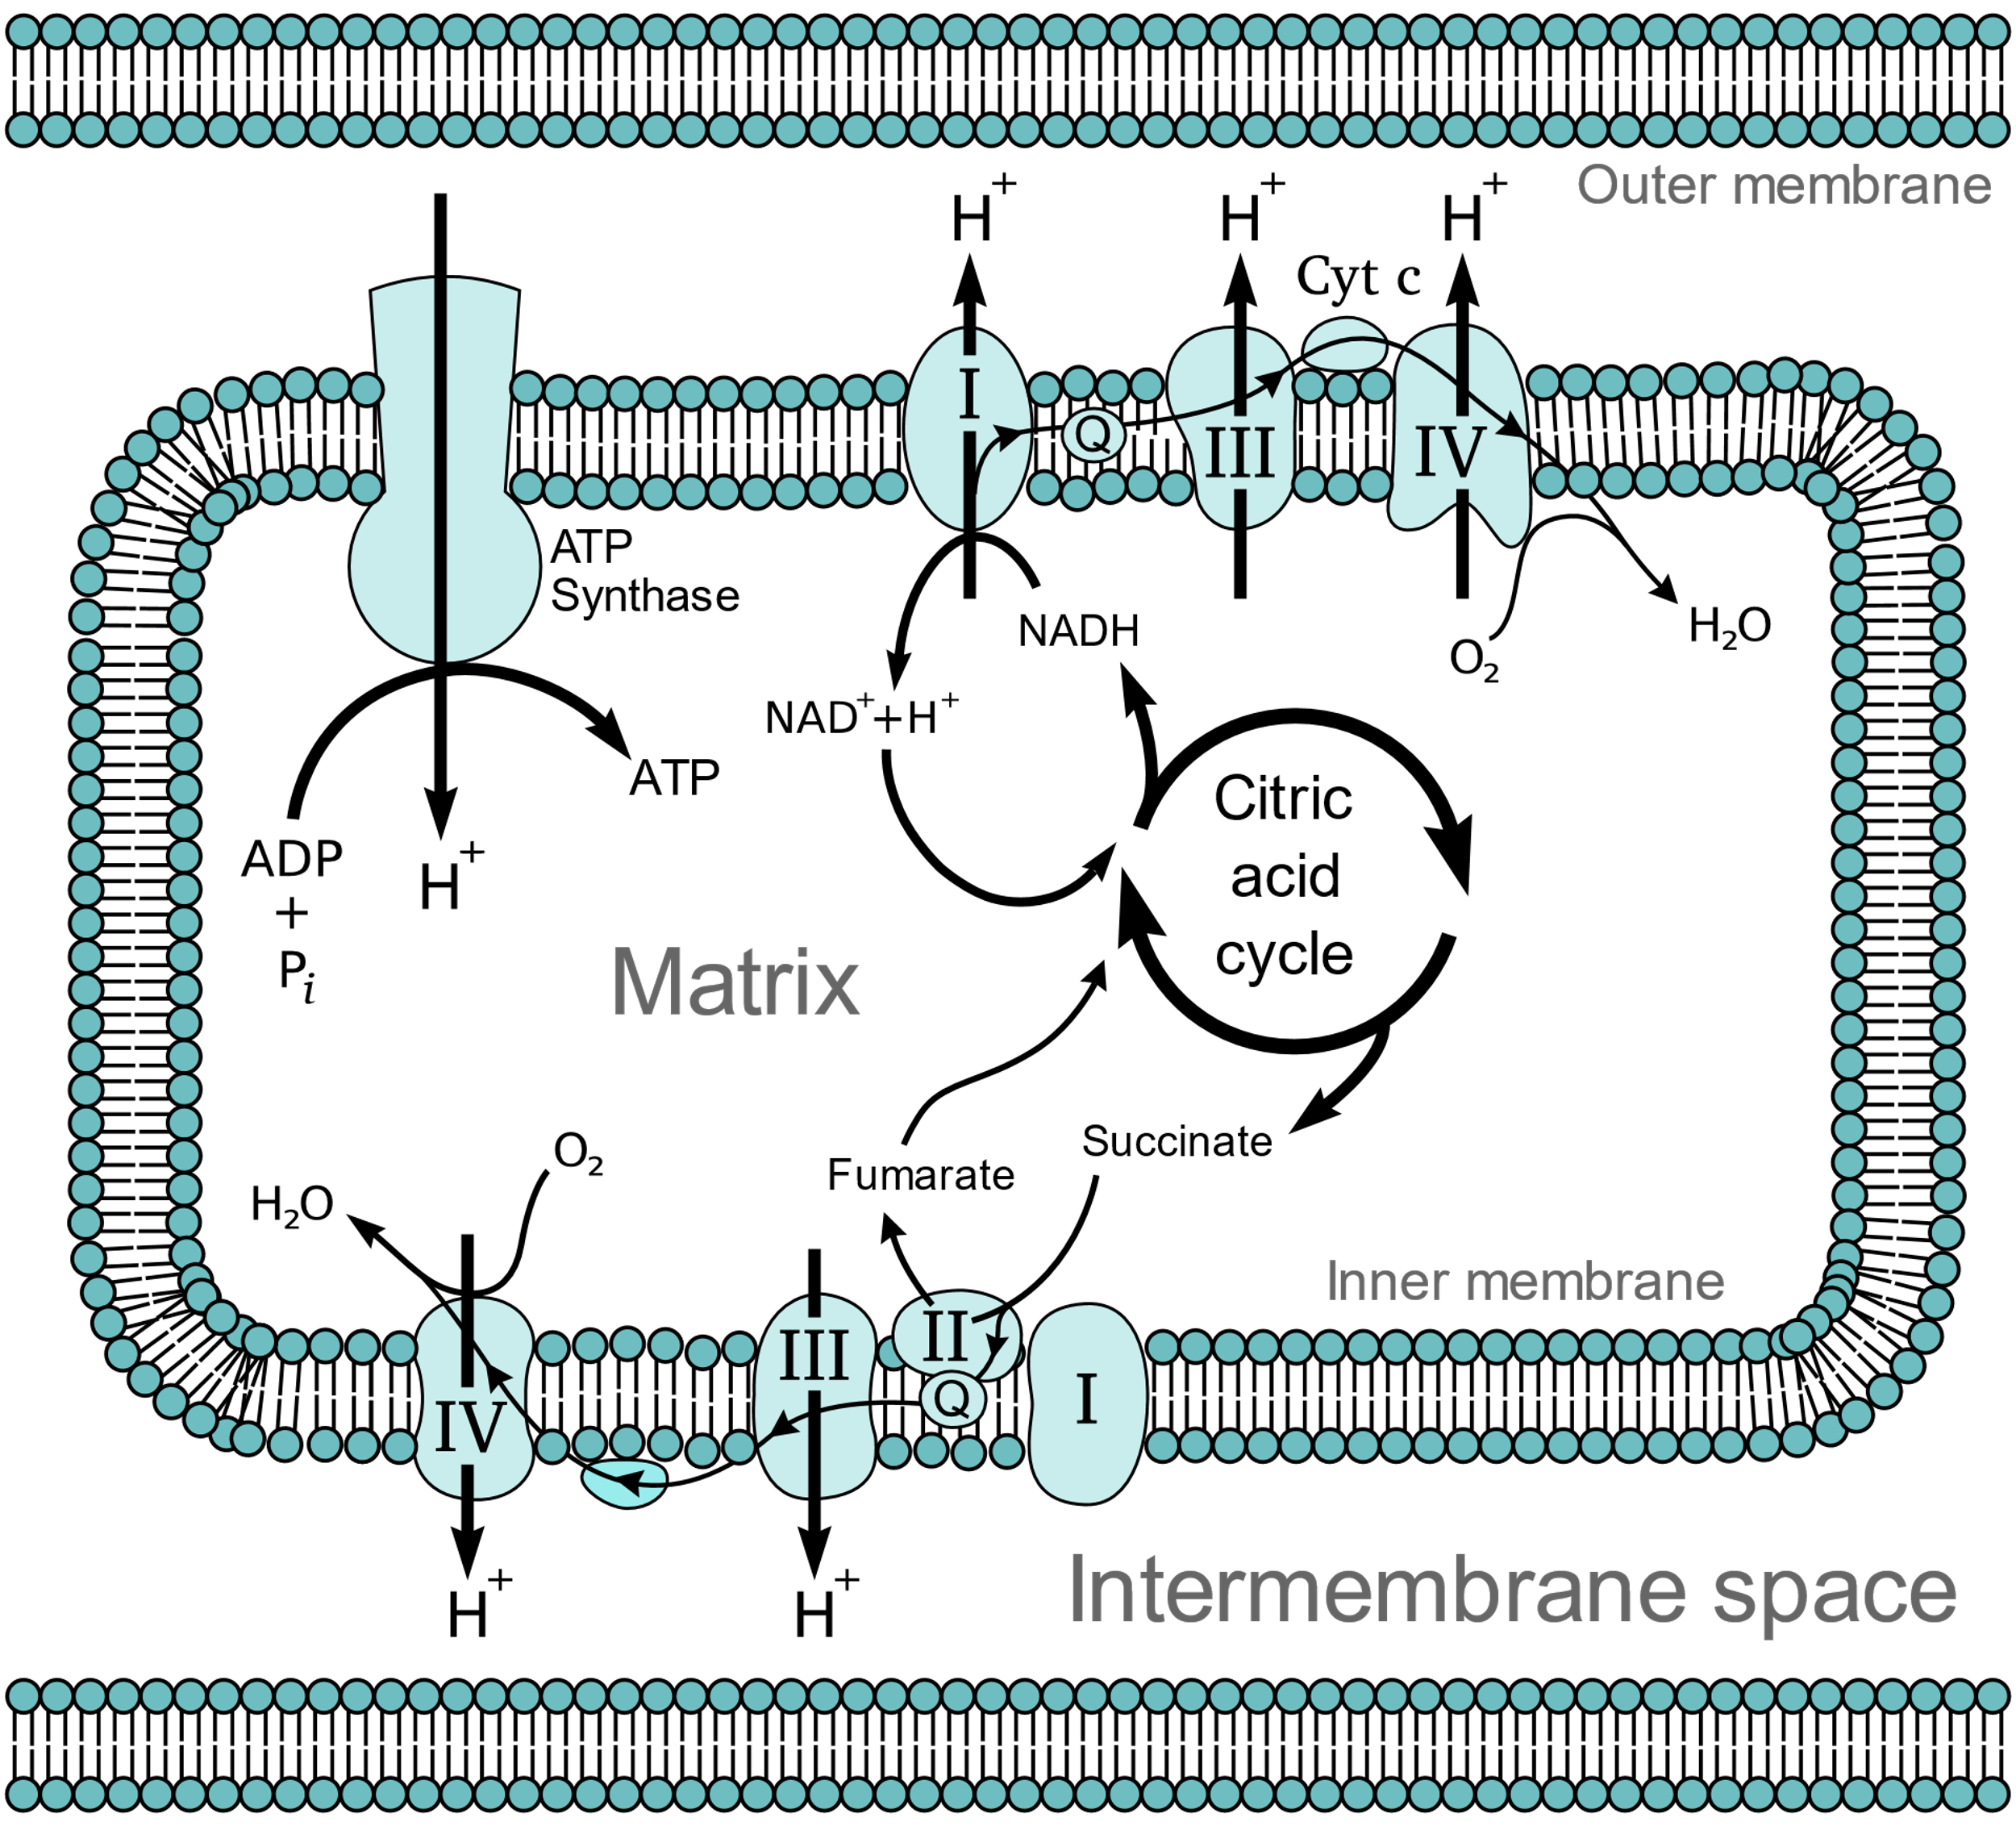
ELECTRON TRANSPORT CHAIN
Notes:
Glycolysis, beta oxidation, and citric acid cycle help in the production of cofactor NADH.
This is a coenzyme that is comprised of electrons with high transfer potential. The NADH removes electrons which are passed to oxygen. Then, they are passed through a sequence of enzymes. Each of these enzymes release small amounts of energy (Weber et al 58).
The set of enzymes basically have complexes I through IV. It is then referred to as electron transport chain.
In eukaryotes, the enzymes found in the electron transport system use the energy that is released from oxygen by NADH. It pumps the protons past the inner membrane of the mitochondrion.
This process lead to building of protons in the intermembrane space. There is generation of an electrochemical gradient past the membrane.
The energy that is stored in this potential is usually used by ATP synthase and helps in the production of ATP.

Slide 7
Combined oxidative phosphorylation deficiency
This is known as infantile hypertrophic cardiomyopathy.
It is characterized by a reduced level of mitochondrial complexes.
The signs and symptoms characterized with this condition comprise of an enlarged heart muscle, eye problems, head ache, fatty liver and paralysis of one side of the body.
The combined oxidative phosphorylation deficiency is caused by the GFM1 gene mutation which is basically leads to mitochondrial dysfunction.
Such cases can be inherited in a autosomal recessive pattern.
Notes:
The GFM1 gene gives instructions for the production of enzyme referred to as mitochondrial translation elongation factor G1. The enzyme is located in cell structures mitochondria.
The mitochondrial translation elongation factor G1 responsible for the release of proteins from mtDNA genes in a process known as translation. The role of the enzyme in translation is to ensure there is a good coordination in the movement of mtRNA molecules (Perli et al 5108).
The genes on the mtDNA gives instructions to proteins which are involved in converting energy from food into form that cells can use also referred to as oxidative phosphorylation.
GFM1 gene mutation leads to a reduction of mitochondrial translation elongation factor G1 function and few mitochondrial proteins are produced during the oxidative phosphorylation process leading to a combined oxidative phosphorylation deficiency which affects organs with high energy demand like the heart, brain and liver(Weber et al 58).
With a shortage in energy supply in tissues of these organs, it results to death of cells leading to problems like liver failure, and neurological problems.

